Slide 1
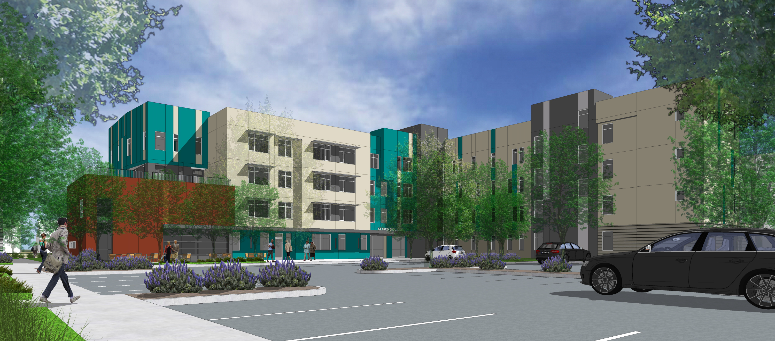


Linnet Corner (NH Senior Housing)| City of Alameda, Alameda County, CA
www.alamedahsg.org

Slide 2
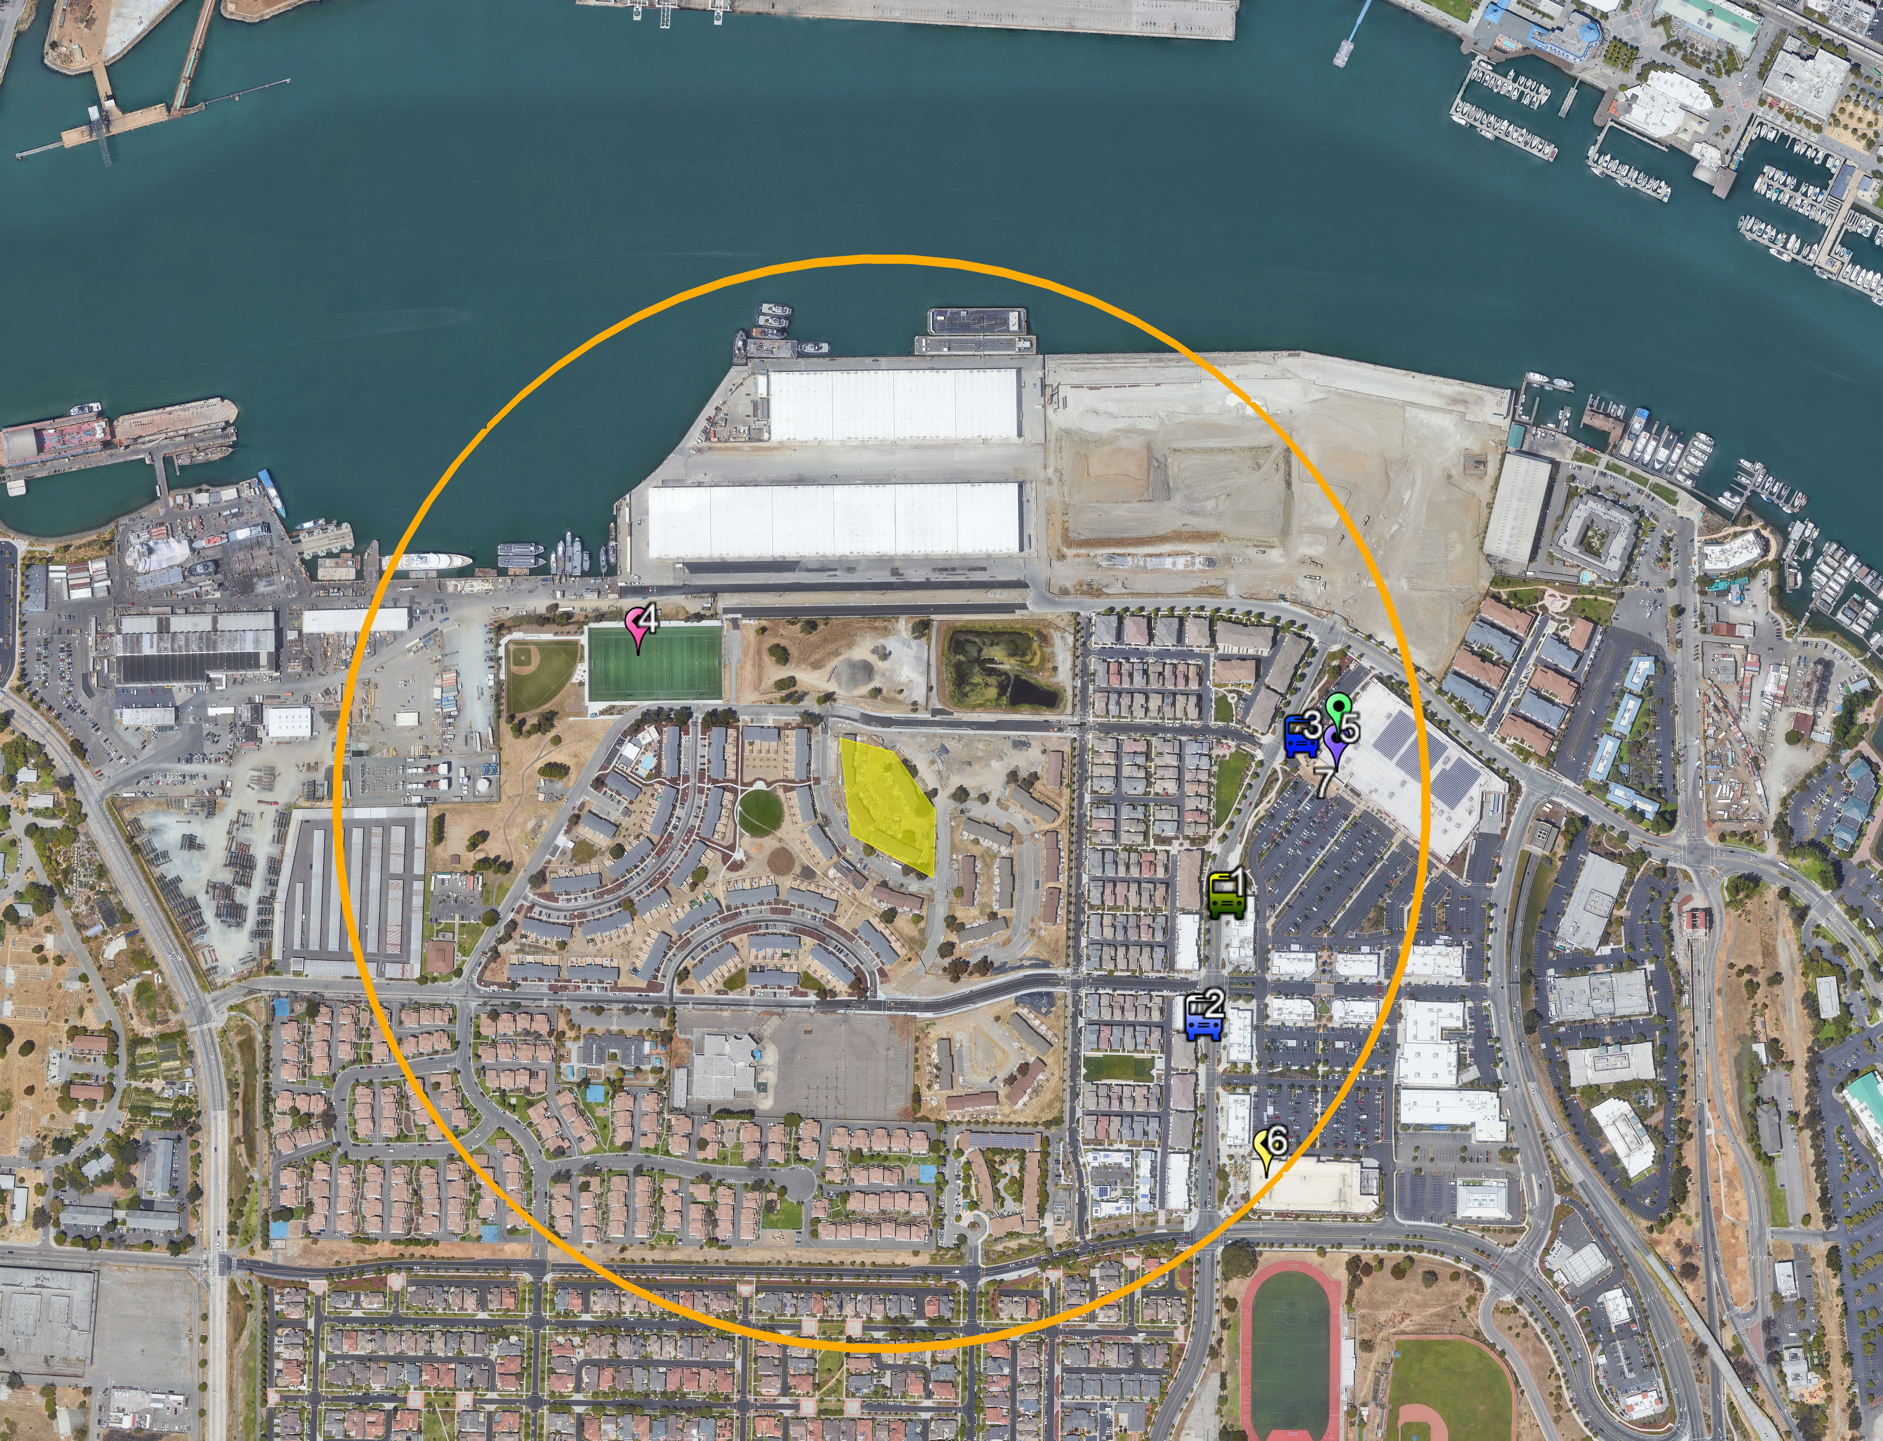
Project Description
Site Amenities
Nearby amenities include transit, Estuary Park, Target, Safeway, CVS Pharmacy, & College of Alameda
Address
2000 Lakehurst Circle, Alameda, CA 94501
Target Population
A total of 64 units targeting seniors and formerly homeless/homeless senior veterans 62+
# of Bedrooms | # of Units | Affordability Levels
Studios | 15 | 30% AMI
Studios | 25 | 40% AMI
One-Bedrooms | 23 | 30% AMI
Two-Bedrooms | 1 | 100% AMI* (*Mgr’s Unit)
www.alamedahsg.org

Slide 3




Development & Operations Team
Ground Lessee - Housing Authority of the City of Alameda
Developer –Island City Development
Architect – HKIT
General Contractor – J.H.Fitzmaurice, INC.
Service Provider – LifeSTEPS
Property Management – FPI Management
www.alamedahsg.org

Slide 4
Financing Structure
Total Development Cost | $53,809,642 (~$840,775 PU)
First Mortgage | $4,235,900
HCD - MHP | $13,474,995
HCD - VHHP | $4,867,201
HCD - IIG | $2,293,116
FHLSB - AHP | $945,000
AAHC – AHHTF & LHTF | $3,438,000
Tax-Exempt Bond Allocation | $27,184,366 (includes $2M supp)
Taxable Tail | $5,562,071
Deferred Developer Fee | $1,400,000
GP Equity | $497,593
Tax Credit Equity - Federal | $22,657,837
www.alamedahsg.org

Slide 5
Key Financial Impacts
Overall hard cost increase in construction costs of approximately $1M
Increased pro-rata share of soil stabilization/ground improvement and overall increase of off-sites for a total of approximately $1.7M
www.alamedahsg.org

Slide 6
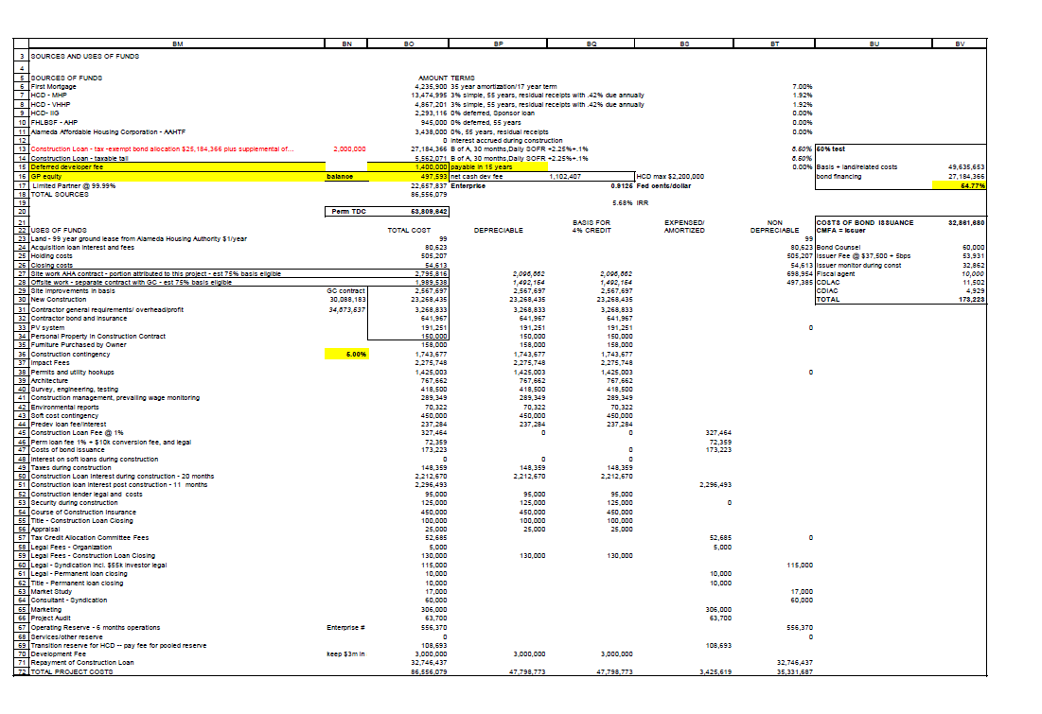
www.alamedahsg.org

Slide 7
Developer Fee
HCD Cash Limitation: $2,200,000
Total Developer Fee: $3,000,000
Cash Fee: $1,600,000
  Closing - $0
  During Construction - $0 (note: GP equity contribution of ~$497k will be requested in development fee from construction loan)
  Conversion - $852,407
  8609 - $250,000
Deferred: $1,400,000 (possibly recoverable from construction cost savings)
Note: Please note the entire development fee is split 50/50 between AHA & ICD
www.alamedahsg.org

Slide 8
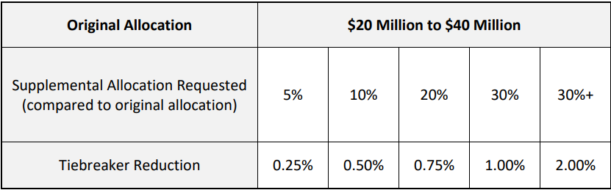
Considerations
Supplemental Bond Request: $2,000,000
Land Value Treatment: Operating Lease at FMV
  Subject to available cash flow
  $100/yr to meet HCD guidelines
  Remaining payments will come through HCD’s sponsor’s share of 50% of RR
www.alamedahsg.org

Slide 9
RECOMMENDATION
Adopt the Authorizing Resolution No. 1067 for the Ground Lease and Cash Loans and Approve the Financing and Ownership Structure for Linnet Corner
www.alamedahsg.org

